Slide 1
HR Promotion Prediction
ML- Hackathon
17-11-2024
Prepared by : Pon Ezhil

Slide 2
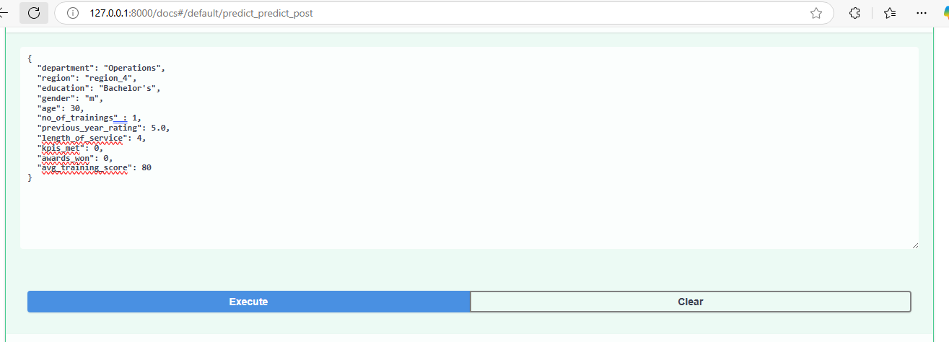
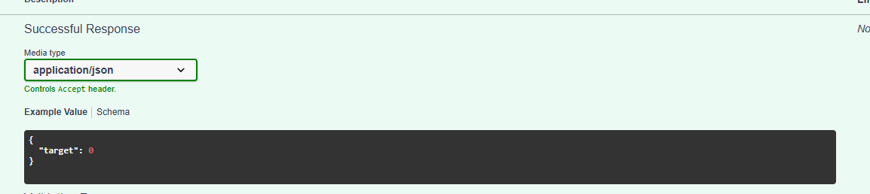
HR Promotion Prediction -

Slide 3
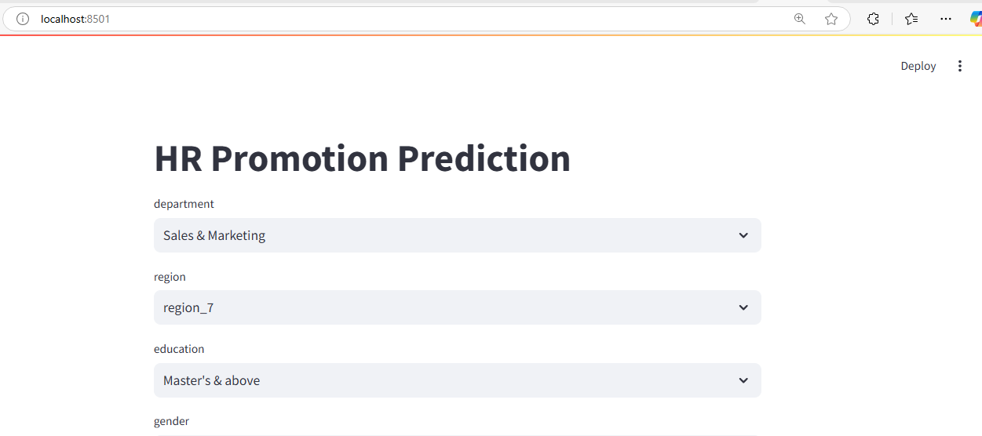
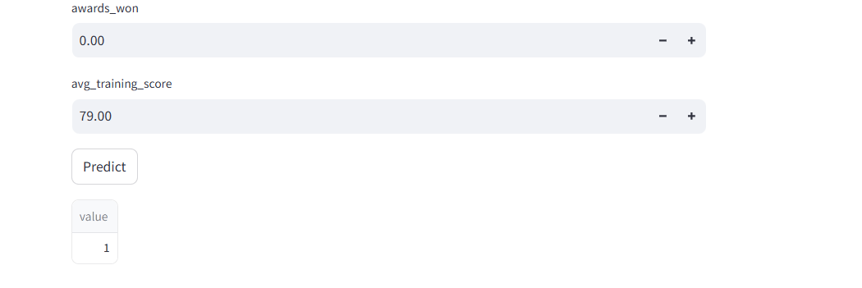
HR Promotion Prediction -

